Slide 1
Precision Medicine Initiative
What does it really mean for us?
Simon Fitall
Galileo Analytics

Slide 2
Disclaimer
Anna McCollister-Slipp, Co-Founder of Galileo Analytics, is directly involved as Co-Principle Investigator for one of the PMI projects funded in the summer of 2016. This presentation and all associated remarks have been prepared without input from Anna or anyone else associated with a specific PMI project as this would breach the terms of the grant approval.

Slide 3
What is the Precision Medicine Initiative?
PMI is NOT
A single grant program launched by President Obama in 2015 and funded by NIH
PMI is…..
A large grant program launched by President Obama in 2015 and funded by NIH
Plus - A series of significant research initiatives run by most major research centers
Plus - Another series of research initiatives run by most major delivery networks
The PMI is as much a philosophy as it is an individual program of research
Grant funding so far for:
Recruitment of participants, collection of their data
Establishing methods and protocols for data capture and storage
So what does this mean for us in the pharma / biotech industry?

Slide 4
The President launched the PMI like this:
“Doctors have always recognized that every patient is unique, and doctors have always tried to tailor their treatments as best they can to individuals. You can match a blood transfusion to a blood type — that was an important discovery. What if matching a cancer cure to our genetic code was just as easy, just as standard? What if figuring out the right dose of medicine was as simple as taking our temperature?” - President Obama, January 30, 2015

Slide 5
The President launched the PMI like this:
“Doctors have always recognized that every patient is unique, and doctors have always tried to tailor their treatments as best they can to individuals. You can match a blood transfusion to a blood type — that was an important discovery. What if matching a cancer cure to our genetic code was just as easy, just as standard? What if figuring out the right dose of medicine was as simple as taking our temperature?” - President Obama, January 30, 2015

Slide 6
And then when talking about the Cancer Moonshot project, the President said:
“And what they've done is to mobilize researchers, scientists, doctors, hospitals, tech companies, as well as philanthropies and patients advocacy organizations, …….. the capacity of big data to analyze cohorts and our ability to now start our pooling together hundreds of thousands or millions of genetic samples that rapidly accelerate our ability to engage in research……. I know that Joe and Jill and I and Michelle will all continue to be involved after we’ve left this office in making sure that this works.” - President Obama, October 17th, 2016

Slide 7
And then when talking about the Cancer Moonshot project, the President said:
“And what they've done is to mobilize researchers, scientists, doctors, hospitals, tech companies, as well as philanthropies and patients advocacy organizations, …….. the capacity of big data to analyze cohorts and our ability to now start our pooling together hundreds of thousands or millions of genetic samples that rapidly accelerate our ability to engage in research……. I know that Joe and Jill and I and Michelle will all continue to be involved after we’ve left this office in making sure that this works.” - President Obama, October 17th, 2016

Slide 8
More recently there has been the 21st Century Cures Act AND a new administration!
21st Century Cures Act put a substantial body of research funding in place on a genuinely bipartisan basis
New HHS head is pro-industry Tom Price – but he also said that Government may need to get more involved in drug price management
CMS is now headed by Seema Verma, a known advocate for significant changes to Medicaid
Scott Gottleib is the proposed new head of the FDA – and he has a long history of being pro-pharma as well as being in favor of faster drug approval processes
The President has stated multiple times that bringing down drug prices is a target

Slide 9
We really need to find better ways to focus care

Slide 10
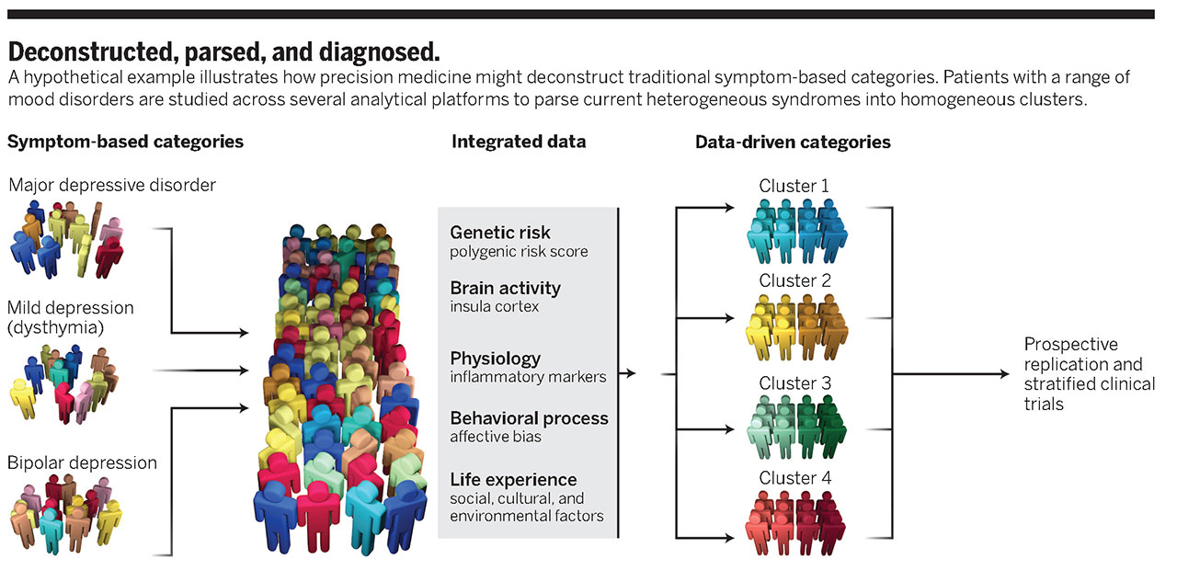
And better ways to design research studies

Slide 11
So what does all this mean for PMI?
First – we have no real idea
the real new health policy and associated bills haven’t passed
statements of intent and policy are frequently quite different
in the short term PMI funding is in place
Second – PMI is a state of mind and philosophy
changes to health policy are very unlikely to diminish the trend towards PMI
many PMI programs are independent of Government funding
Third – just about everyone in healthcare delivery knows that PMI is essential
Source: https://www.nih.gov/research-training/allofus-research-program/funding

Slide 12
So how is NIH funded PMI working? Funded programmes:
Patient data recruitment
University of California
Cedars-Sinai, San Diego Blood Bank, UC Davis, UC Health, UC Irvine, UC San Francisco, USC Los Angeles
Partners HealthCare System
Boston Medical Center, Boston University
Henry Ford Health System
Baylor Scott and White Research Inst, Essentia Health, Spectrum Health, Umass Medical school
Geisinger Health System
Columbia University
NYC Health, NY Presbyterian, Weill Cornell Medicine
Northwestern university
Alliance of Chicago Community Health Services, Anne & Robert H. Lurie Children’s Hospital Chicago, University of Chicago, Univ of Illinois at Chicago
University of Arizona
Banner Health
University of Pittsburgh
Vanderbilt University with Verily and Broad Institute
Columbia University Med Ctr, Northwestern Univ Med Sch, Univ Michicigan Sch of Public Health, UT Health Science Center at Houston
Source: https://www.nih.gov/research-training/allofus-research-program/funding

Slide 13
So how will the PMI work? Funded programmes:
Community Health Center approach
Cherokee Health Systems, Community HC Middletown CT, Eau Claire Coop HC, Columbia SC, HRHCare Peekskill NY, Jackson-Hinds HC Jackson MS, San Ysidro HC CA
HRSA, MITRE Corporation
Patient recruitment and data collection (via web site and mobile apps)
Scripps Research Institute, Vibrent Health
PatientsLikeMe, Sage Bionetworks, Walgreens
PMI Biobank – Mayo Clinic
Communications design and development – Hungry Heart Media Inc
Communication Implementation – HCM Strategists LLC
Participants interface (web site) – Vanderbilt University
Standardization of open source apps - ONC
Source: https://www.nih.gov/research-training/allofus-research-program/funding

Slide 14
Potential Data Uses
All analyses will be subject to thorough design scrutiny
Academic researchers are likely to be given priority
Commercial uses of data are likely to be heavily restricted (like the UK)
Pure data exploration is unlikely to be approved – there must be a hypothesis
ALL results based on PMI data will be in the public domain
Research issues…..
Relating health conditions to diet, exercise, pollution
Overlaying genetics on conditions
Overlaying biomics on conditions
Exploring genetic/biomic/environemntal factors in drug efficacy
Treatment comparisons across cohorts
Phase IV studies – with or without the drug manufacturer
Etc…….. (in effect, what ever a researcher can hypothesise and fund)

Slide 15
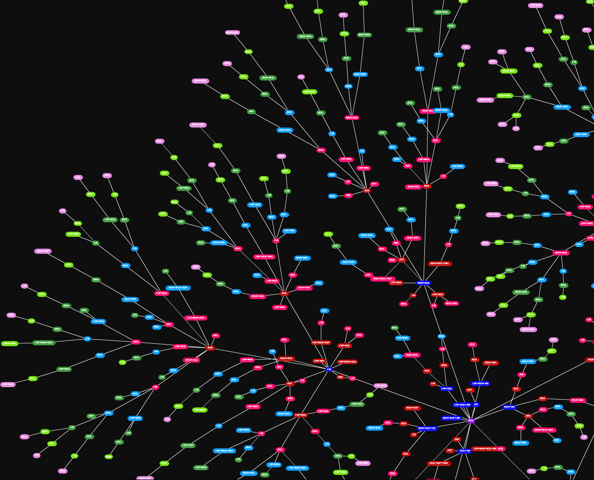
Research Implications – PMI Data Flows
Data capture from centers and individuals
Addition of sample based data
Such as
Genomic/biomic/etc
Academic Research Center analysis
Public Availability

Slide 16
Brief history lesson (for all of you who haven’t been in the industry for over 20 years)
The power of the pharma industry derives from controlling the data
Clinical trials that define the efficacy and safety of drugs
Phase IV studies that show the power of the drugs in a real world setting
Pharma have consistently defined both the disease and the treatment
Sales by brick from which prescribing could be derived
In the USA Rx by named physician
Real World Data that provides detailed longitudinal profile of individual patients
Pharma have consistently controlled the commercial environment
Global sales 2000 c. $ 200 Bn
Global sales 2015 $1,072 Bn

Slide 17
Research Implications for Pharma/Bio – the new Patient Journey
As a practical example show how patient journey research now includes the Rx flow, the emotional flow and now also both Dx and Px flow
Traditional patient flow analysis:
Patient journey:
Dx 1
Drug 1
Add Drug 2
Dx 1+2
Drug 3
Add Drug 4
Emotional context
Emotional context
Emotional context
Emotional context
Dx 1
Drug 1
Add Drug 2
Dx 1+2
Drug 3
Add Drug 4
The PMI business model makes this very much more complex

Slide 18
Research Implications for Pharma/Bio – the new Patient Journey
As a practical example show how patient journey research now includes the Rx flow, the emotional flow and now also both Dx and Px flow
Dx 1
Dx 1+2
Emotional Input
Emotional Input
PMI Data
Dx 1+2+4
Symptom 1+2
Emotional Input
Test 1
Drug 1
Drug 1+2
Drug 2 + dose
Drug 4
Drug 5
Drug 7
Emotional Input
Emotional Input
Symptom 3
Drug 3
Test 4
PMI Data
Drug 6
Test 2
Dx 3
Test 3
Dx 3+5
Emotional Input
Emotional Input

Slide 19
What that means in practical terms
There will certainly be research looking into:
Improved diagnosis of disease using broader biometric measures
Revisions to clinical end points based on broader biometric measures
Using more active patient engagement to improve disease management
Real-time monitoring of chronic conditions (eg diabetes, stroke risk)
Exploration of data capture methods including nutrition, exercise
There is likely to be research looking into:
The genomics of drug efficacy, tolerability and safety
Treatment protocol comparisons seeking more effective / efficient approaches
Use of real-time monitoring to modify treatment practices, linked to better end-points
Modifying treatment protocols based on complex co-morbidities

Slide 20
The Implications for Pharma / Bio
With research institutions and academic bodies completing research into all aspects of drug use, it is possible that pharma / bio will be cut out of drug choice decisions!

Slide 21
The Implications for Market Research and Business Intelligence
With new data types available, new decisions being made, new managerial issues to be dealt with and new market environment to map – the opportunities could not be any more exciting!

Slide 22
Precision Medicine Initiative
What does it really mean for us?
Thank You – Q&A
Simon Fitall
Galileo Analytics
Simon.fitall@galileoanalytics.com

